Slide 1

Group 2: Credit Card Approval Prediction
Cody Gardner
Bradley Barker
David Owens
Marie Prosper

Slide 2


Overview
Background
Goal
Technologies and Data Source
Process
Machine Learning
Website
Model Usage

Slide 3

Background
Applying for a credit card can be intimidating for some people. Many applications ask for your social security number and your credit may get hit with a hard inquiry. We wanted to use a machine learning model remove this friction.

Slide 4

Goal
To predict whether the credit card application will be approved or denied.
Show approval predictor
Show denial predictor
Predicts the odds based on:
Number of Children
Household Income
Family Size
Gender
Own Car
Own Realty
Regression Model

Slide 5












Technologies
Data Source
Python (Jupyter Notebook, Pandas, numpy, sklearn, matplotlib)
Flask
SQL/ Postgres DB
HTML/ CSS (Bootstrap)
CSV
Machine Learning
https://www.kaggle.com/rikdifos/credit-card-approval-prediction
Notes:
MARIE

Slide 6
Process
Data Cleaning
Removing extraneous columns
Null values
Duplicates
Merging datasets by grouping the datasets
Individual scatter plots for each feature
Regularization: Coefficient plots XXXX
Function to test the familiar Regressors
Scaling the data – XXXXX
Model Selection & Prediction
MSE & R-squared score: Lesson Learnt
Exported the model
Flask implementation
Heroku deployment

Slide 7
Machine Learning
Notes:
CODY

Slide 8
TEST 123

Slide 9

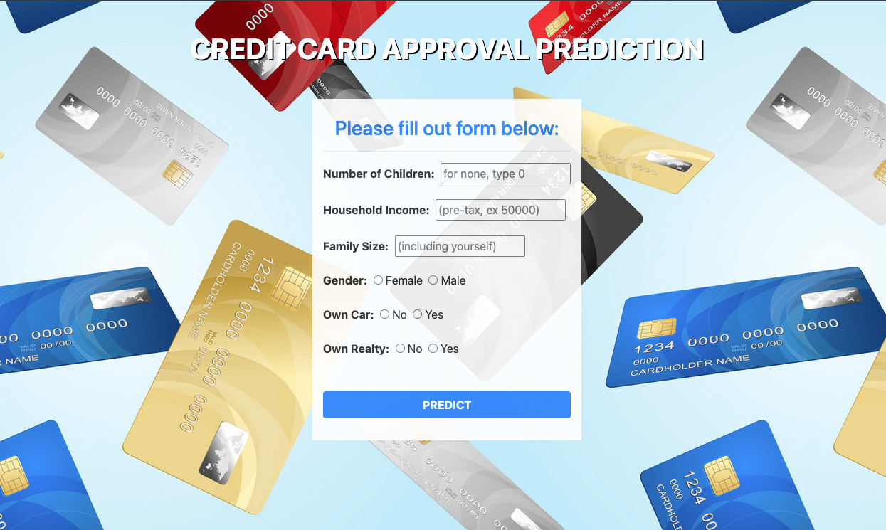

Website
SCAN ME:
Notes:
BRADLEY

Slide 10
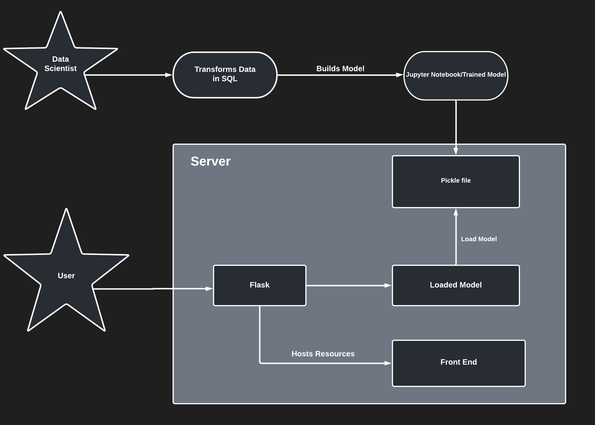
Model Usage
Notes:
DAVID

Slide 11
Limitations

